Slide 1
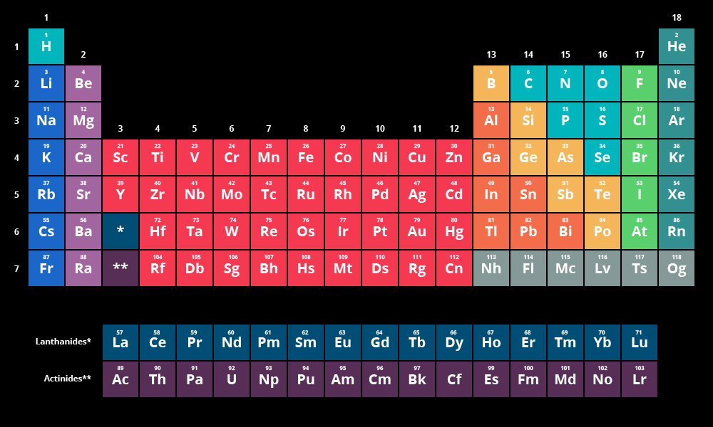
DIGITAL MODERN PERIODIC TABLE (using C)
BY- Govind jha
aadi kumar
Aditya dangwal

Slide 2
MODERN PERIODIC TABLE
The modern or long form of the periodic table is based on the modern periodic law. The table is the arrangement of elements in increasing order of their atomic numbers. The modern periodic table is the present form of the periodic table. And it consists of 18 vertical columns and 7 horizontal rows.

Slide 3
OBJECTIVE
The key features of Modern Periodic Table mini project in C are briefly described below: • Storage of Element Information: In the project, you can add any new element with its name, symbol, atomic number, atomic weight and its some important properties. When new element information is to be added to this Modern Periodic Table, you have to enter 1 in the main menu and input information in given format. These information are stored in file created on the hard disk of computer by program itself. • Exploration of element Information: Another main function of this project is to explore or to display the stored information. You can search an element by using any of the following method:
By name of element
By symbol of element
By atomic number of element
By atomic weight

Slide 4
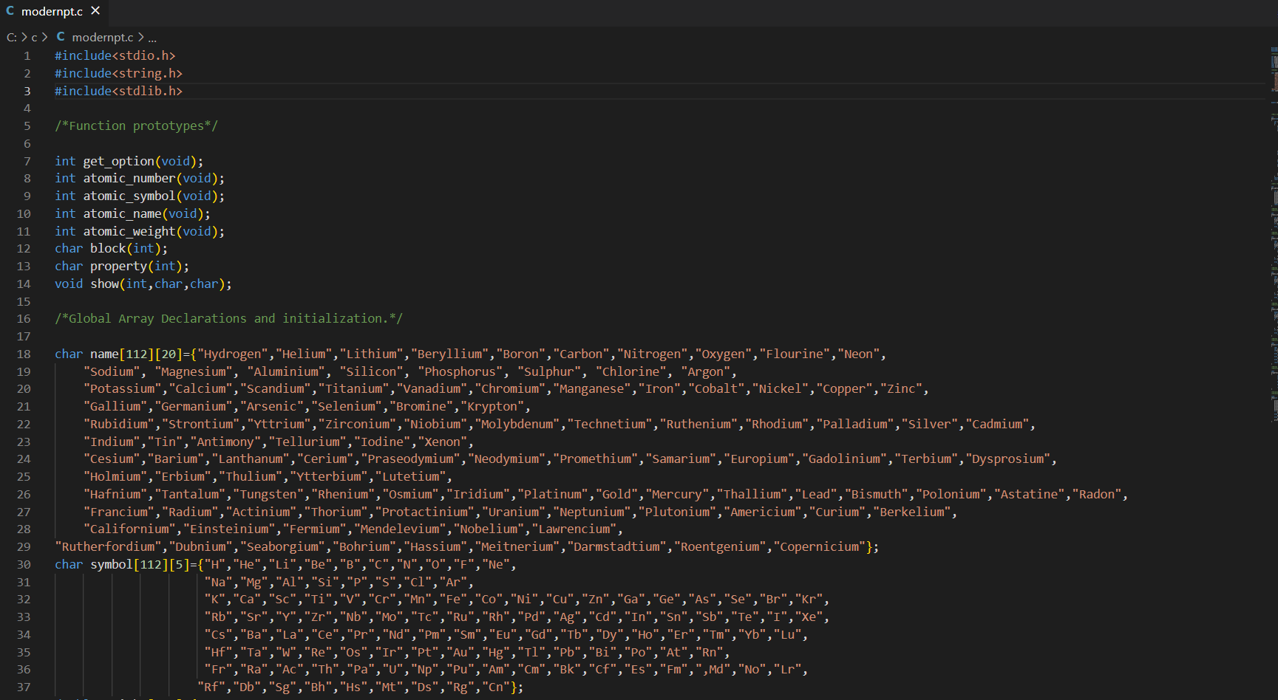
PROJECT INSIGHTS

Slide 5
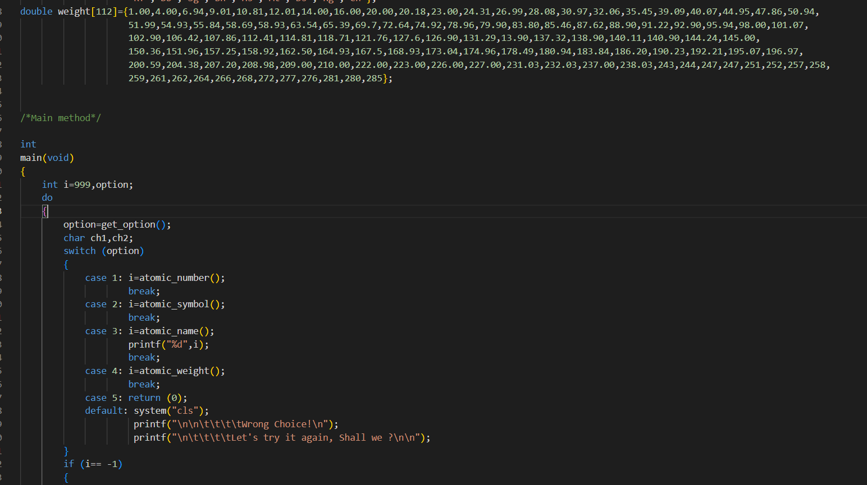

Slide 6
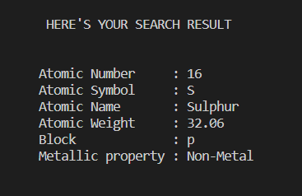
OUTPUT

Slide 7
THANKYOU

